Slide 1
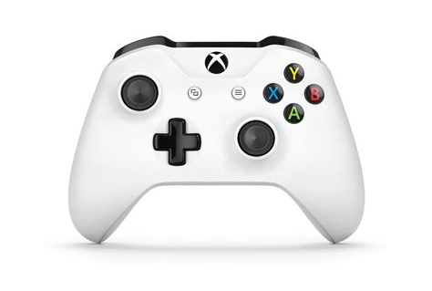
Joystick 0 Controls
Left Bumper: Defensive Pivot
Left Trigger: Fire Control Override
Right Bumper: Toggle Intake Deploy
Right Trigger: Auto-Targeting
Y axis(north/south): Strafe Front/Back
X axis(east/west): Strafe Port/Starboard
Press button: Emergency Boost
Feeder Station Mode
Enter Robot Oriented
Clear Errors
Enter Field Oriented
Signal Human Player
Reset IMU
Rotate Drive Base
Rumbles: Auto-Targeting
Written by Amelia and Amelie

Slide 2
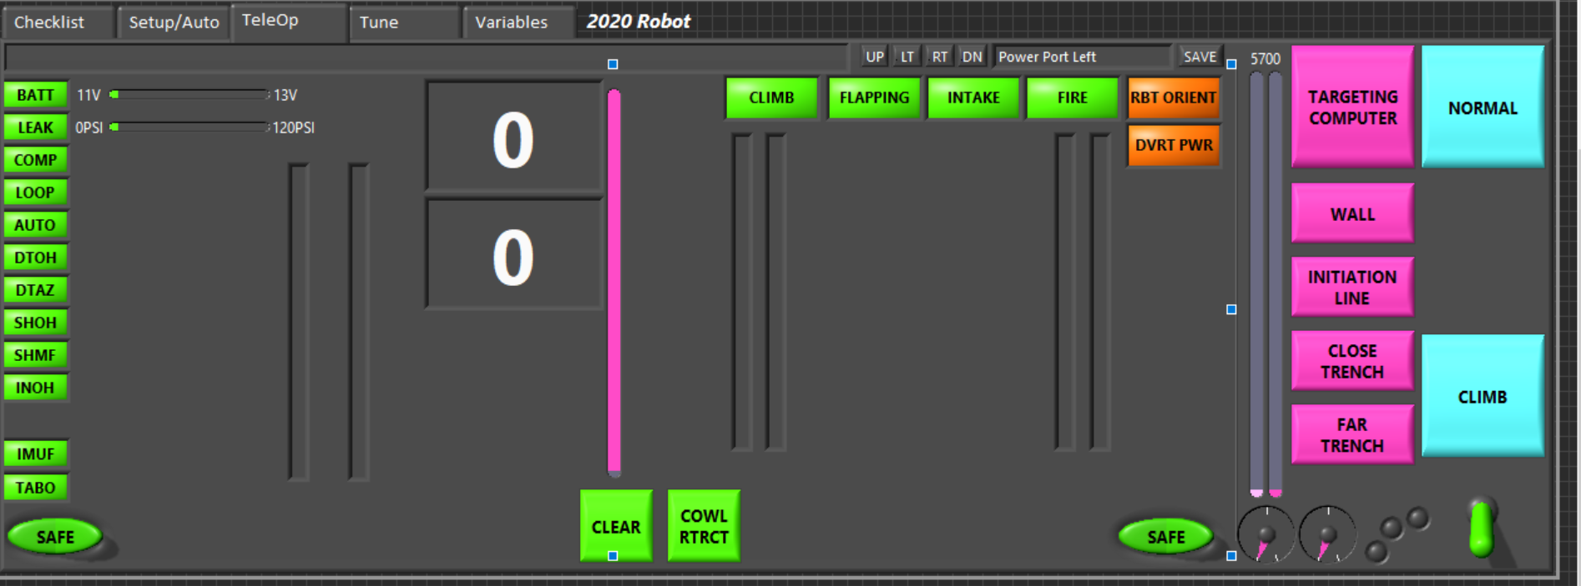

Slide 3
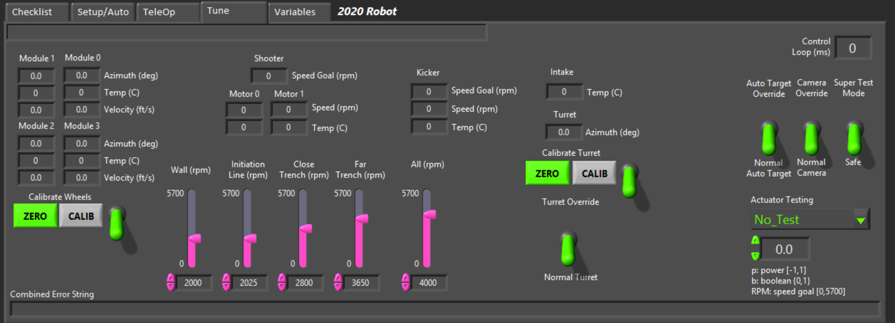

Slide 4
